Slide 1

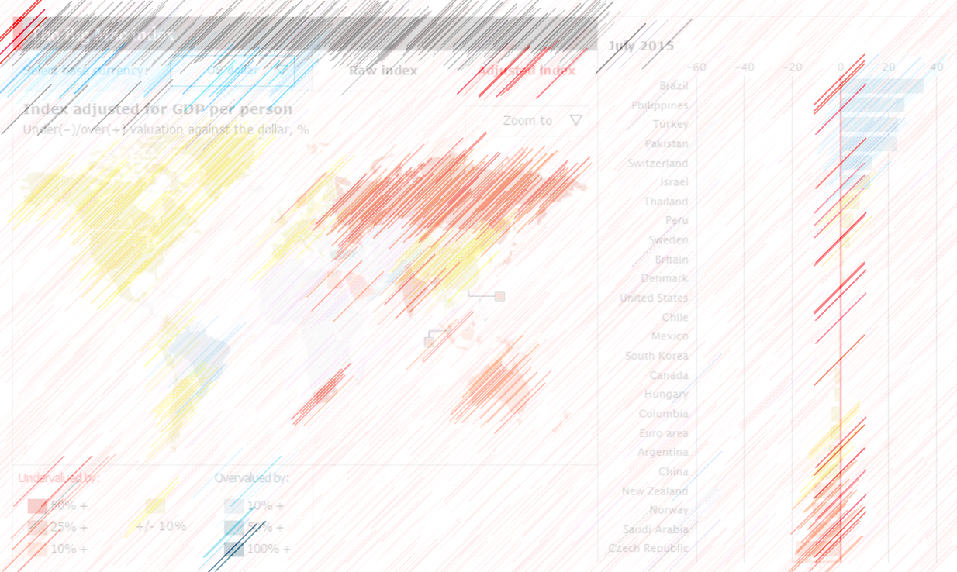
Ethical Visualizations Presentation
ALY 6070_Communication and Visualization for Data Analytics
Summer 2020 CPS Quarter
Instructor: Alli Maurer, PhD
Yuyi Zhang
Jul 20, 2020
Notes:
In this report, I’m going to present 4 visualizations. First two are Big Mac index charts that illustrate the purchasing-power parity level of a bunch of countries by comparing the price of big mac burger. The 3rd chart is an ad of Microsoft Edge. We’ll see how it would mislead audience that Edge was much faster than its competitors. The last one is a map of poverty rates in Europe. In the end, will get an idea of what makes visualization ethical and what make them unethical, what would be the impacts for audience.

Slide 2
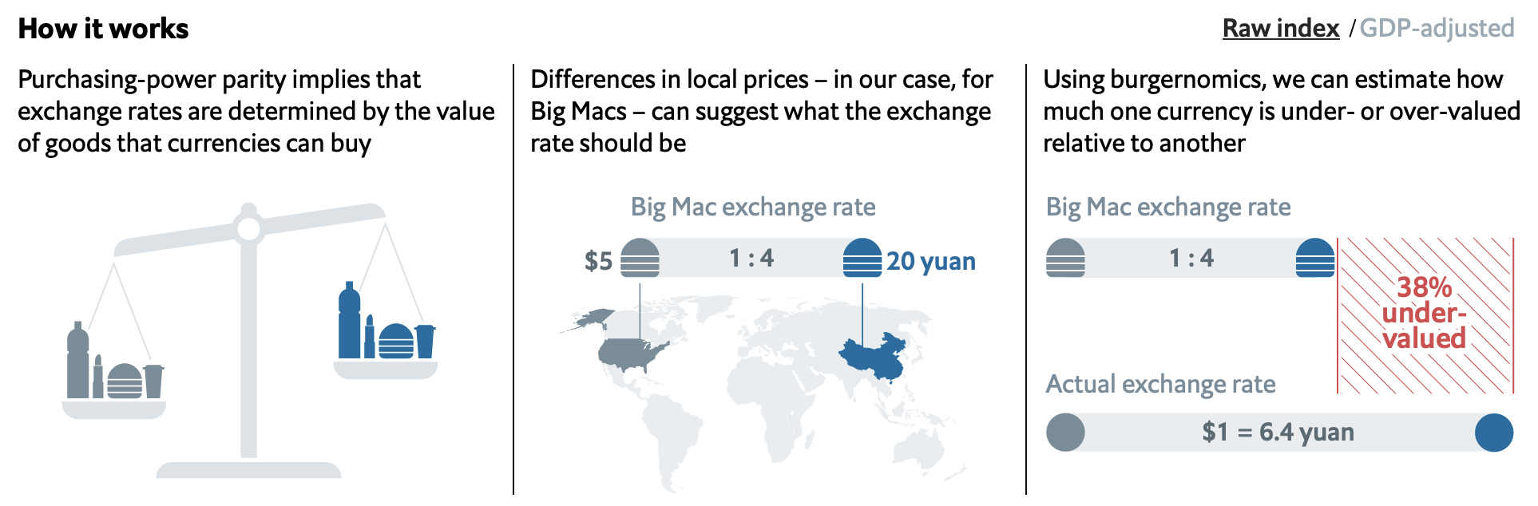
Ethical example 1
Notes:
This is an ethical visualization.
It is a set of charts that explain the concept of ‘The Big Mac index’. The first chart explained purchasing-power parity. This is where the two colors that are going to be used in the following charts have been introduced. The second chart illustrate the price difference between two countries. Mapping is a precise method to demonstrate the logic. The third chart compares calculated and actual exchange rate, then indicates the difference. As an audience, now I can clearly know how does 38% coming from.
Because of the concept has been well explained, now audience would be able to move on to the index map on the next slide.
Reference:
The economist (Jul 15, 2020). The Big Mac index. Retrieved from: https://www.economist.com/news/2020/07/15/the-big-mac-index.

Slide 3
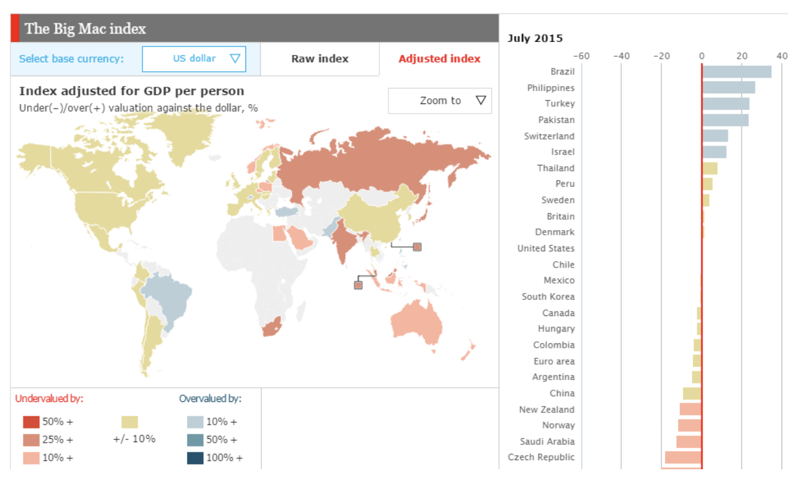
Ethical example 2
Notes:
This is a follow up ethical visualization.
In this map, there are 3 hues, red, yellow and blue. Red is undervalued more than 10%, blue is overvalued more than 10%. The combination of map and bar chart are well explaining the PPP situation worldwide.
The Big Mac index compares the Big Mac burger prices in difference countries. Further, it indicates whether the currencies/purchasing power are at an appropriate level. In the map above, all the index are illustrated as color rather than numbers, which is easier for audience to catch and get a general idea of the worldwide picture. Then there is a char chart aside. It lists all the numbers by color in descending order. Again, easier for viewer to catch the point.
Reference:
Durcevic, S. (Jan 15, 2019). Take Advantage Of The Best Interactive & Effective Data Visualization Examples. Retrieved from: https://www.datapine.com/blog/best-data-visualizations/

Slide 4
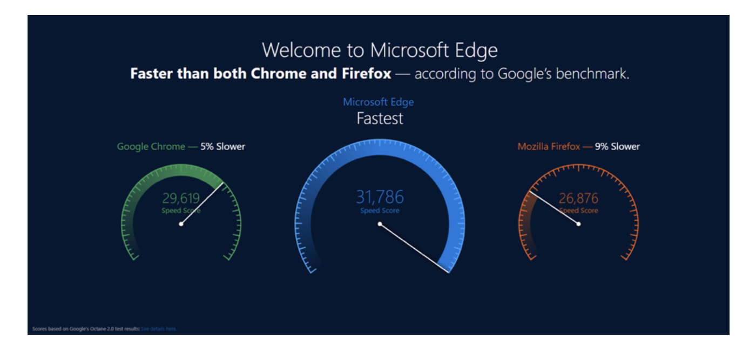
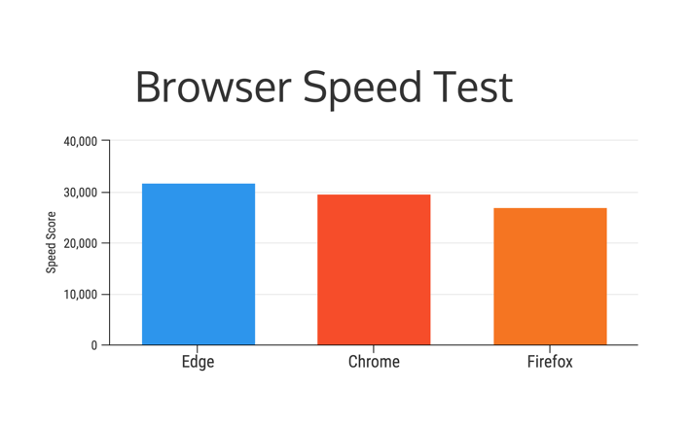
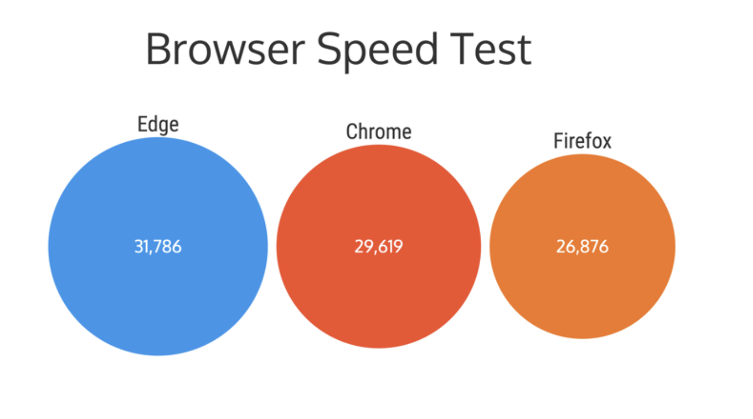
Unethical Example 1
Notes:
This is unethical visualization.
This is a common way of unethical graphics, which is breaking scales to extent the difference that much smaller than it looks. In this data, coming from Microsoft, the speed advantage of Edge is 5% to 9%, rather than 25% to 50% shown as in the chart. It is an unfair comparison.
To fix it, show the full extent of the bars, shown as on the right. Or use the bubble chart. Less fancy, but accurate.
Based on the data provided, Edge is fast, for sure, but not as drama as it looks like. This chart mislead people to believe that Edge is twice as fast as its competitors.
Reference:
Mccready, R. (APR 17, 2020). 5 Ways Writers Use Misleading Graphs To Manipulate You. Retrieved from: https://venngage.com/blog/misleading-graphs/.

Slide 5
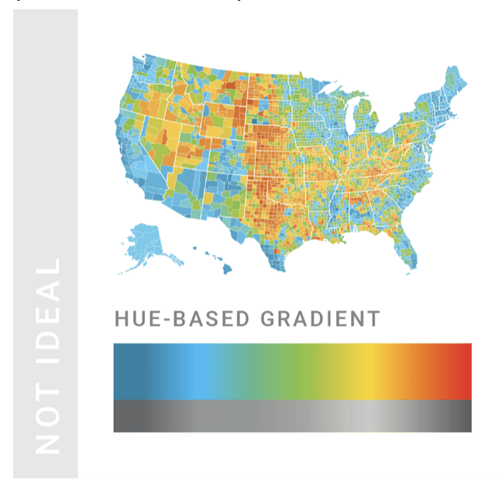
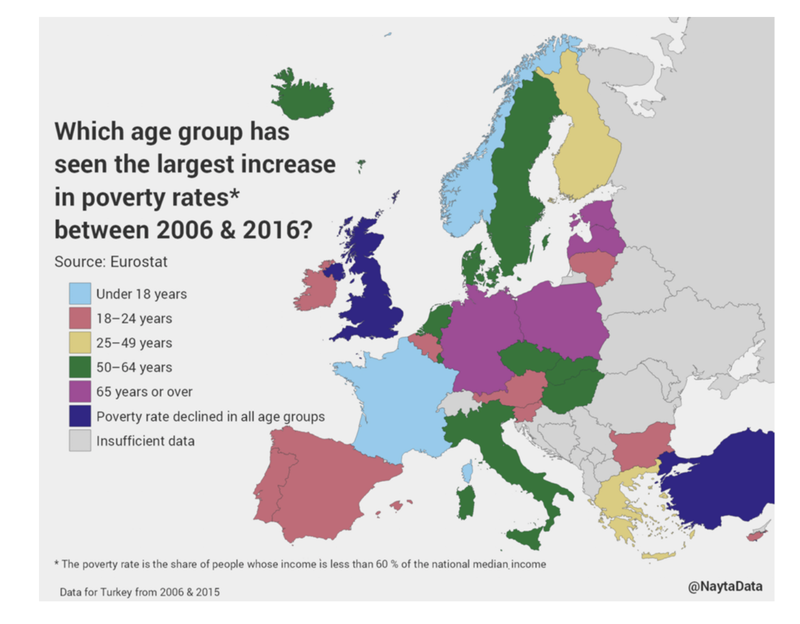
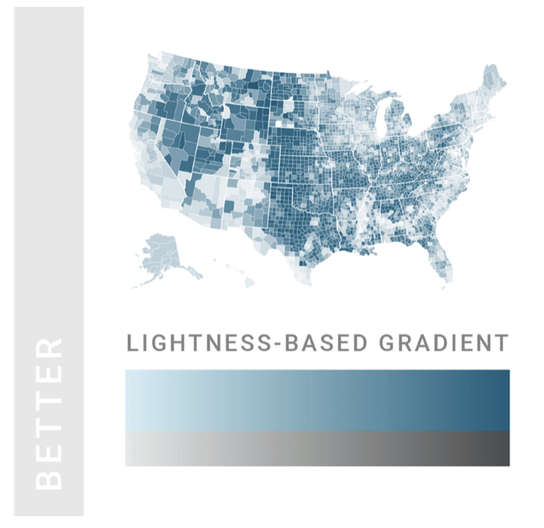
Unethical Example 2
Notes:
Here’s another example of an unethical visualization.
Using color would be one of the ways to enhance the most important values. Using gradient colors to show a pattern would help audience to catch the point easier. But when there are 7 or even more colors in one chart, people could be distracted by frequently consulting the color keys.
Always use single color palette, especially when we are presenting a trend of number from low to high. I have put another example of using single color palette on the right hand side to explain my point.
In this case, more colors may not mislead audience to another direction. But it would make it harder to follow. Less color in a chart would be much easier for audience to read quickly.
Reference:
1. Mccready, R. (APR 17, 2020). 5 Ways Writers Use Misleading Graphs To Manipulate You. Retrieved from: https://venngage.com/blog/misleading-graphs/.
2. Rost, C. What to Consider When Choosing Colors for Data Visualization. Retrieved from: https://www.dataquest.io/blog/what-to-consider-when-choosing-colors-for-data-visualization/.

Slide 6

The end
Notes:
In conclusion, visualization are a great ‘helper’ to communicate with audience than text. People use visualization to make their points easier and more accurate to catch. On the other hand, audience would be much easier to get misled by visualization. Learn and get familiar with elements that make visualizations unethical. Avoid them when we make visualizations; recognise them when we read.

